Slide 1
DSP Platform Firmware and Software Redesign
Final Project Review
Yohan Bopearatchy, Wyatt Duberstein, Blake Fisher, Corbin Kems, Cole Langner, Jens Rasmussen, Long Zeng

Slide 2
Agenda
01 - Introduction
02 - Implementation Architecture
03 - Work Accomplishments
04 - Key Contributions
05 - Challenges & Solutions
06 - Future Work
07 - Conclusion
08 - Appendix

Slide 3
01
Introduction

Slide 4
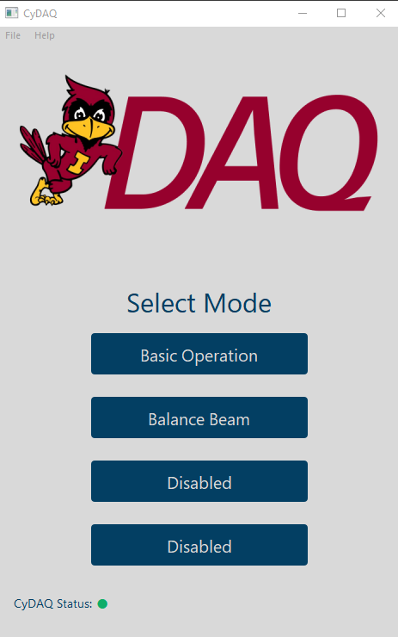
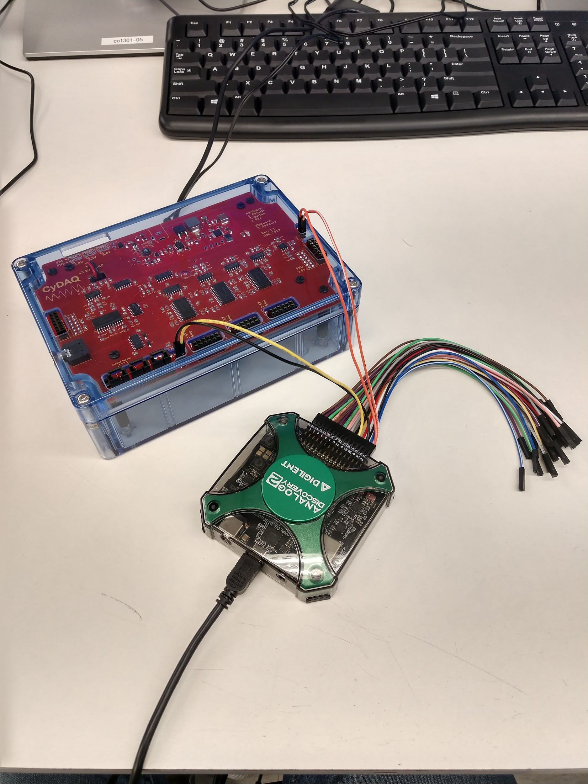
Introduction
CyDAQ board created in 2018 by sdmay18-31
Used in Systems and Signals I/II (EE 224/324)

Slide 5
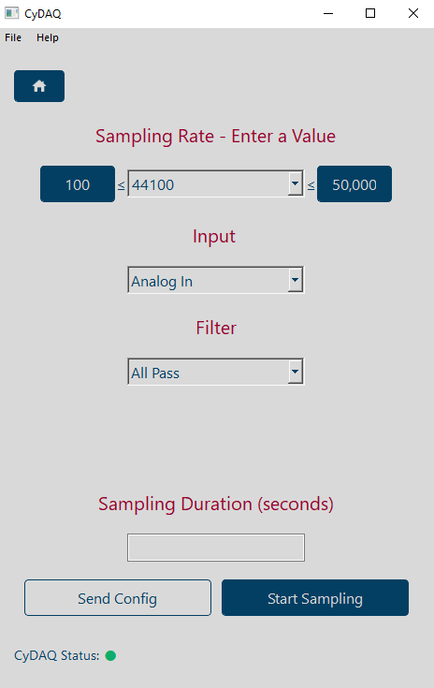
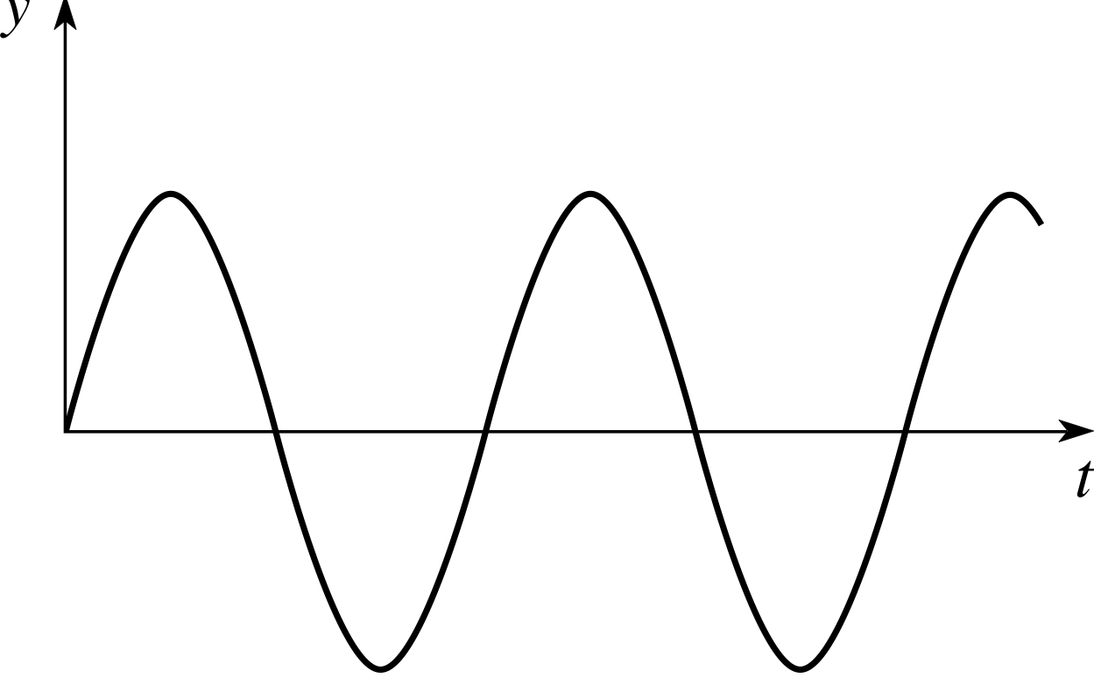
Start CyDAQ Mixer
Configure
Save Data as CSV
Sends Signals
Plot Data
Start
Send Data
Excel, Matlab, etc.

Slide 6
02
Implementation
Architecture

Slide 7
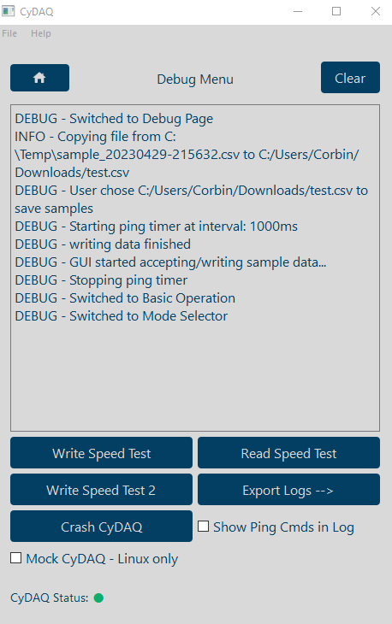
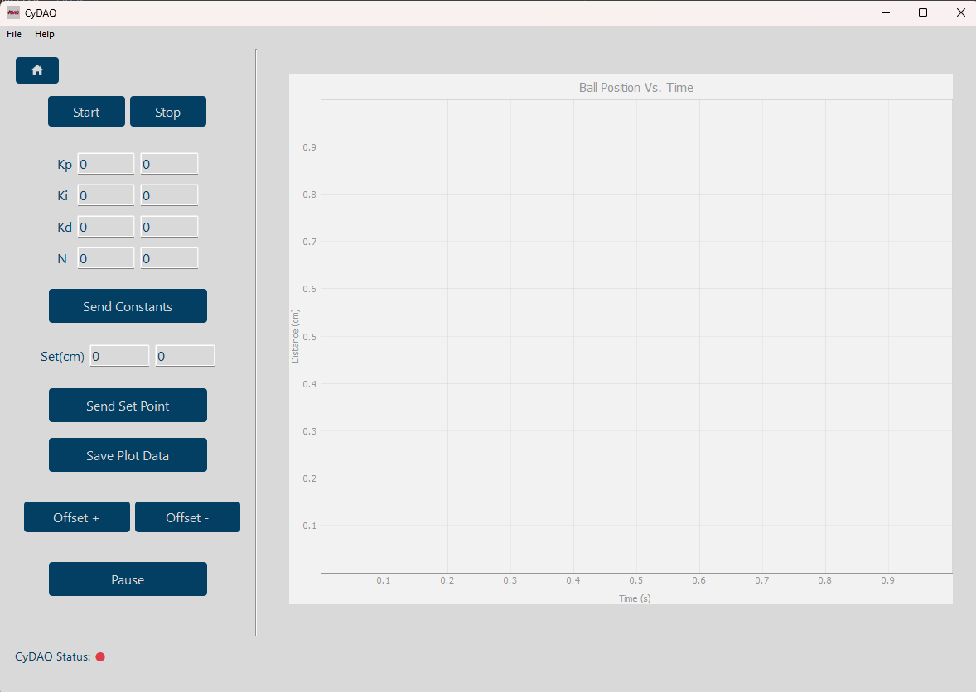
Implementation - GUI
PyQt5
Creates instance of CLI wrapper on startup
Sends commands to CyDAQ through CLI
If the CLI wrapper throws errors they are displayed in a Debug page in the GUI
Notes:
Chose Pyqt5 for our gui framework. It is a python version of the QT framework. It is a library of prebuilt components and it comes with a designer software.
Old mode requires two separate applications
Old mode has 5 different pages, ours uses 1
Chose PyQt5 for our GUI framework. It is a python version of the QT framework. It is a library of prebuilt components and it comes with a designer software. On startup of our app, an instance of CLI wrapper is created. CLI wrapper uses package perfect to generate internal shell sessions, which runs the standard cli tools.

Slide 8
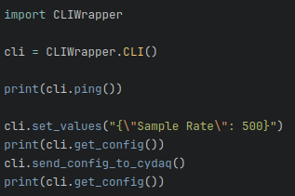
Implementation - CLI
CLI Tool at core
Handles UART commands
Wrapped by the CLI Wrapper Class
Uses pexpect - mimics a user
Allows for simplified API
Notes:
At core, the Command-line interface tool is meant to handle the communication between the user on the user interface and the firmware on the actual device.
It handles UART commands and communication between the user interface and the firmware over USB.
The CLI tool is wrapped by the CLI Wrapper class that we wrote, which is meant to give an added layer to the CLI allowing the user interface to interact with it simply and seamlessly.
(Walk through code snippet and explain what is happening, why it is simple and helpful)
Config validation
Simplified API - Can be used in both raw CLI form and behind user interface
The CLI Wrapper uses pexpect, which is a python library that imitates a user by opening up an command line session and sending commands to it with extra input validation, etc
(Explain diagram on the right)
What is above and below the diagram (user interface, CyDAQ)
How the CLI object works overall
How pexpdect opens a CLI session within the wrapper
How the Wrapper works to wrap the CLI tool and make it useable for raw CLI use or for a user interface

Slide 9
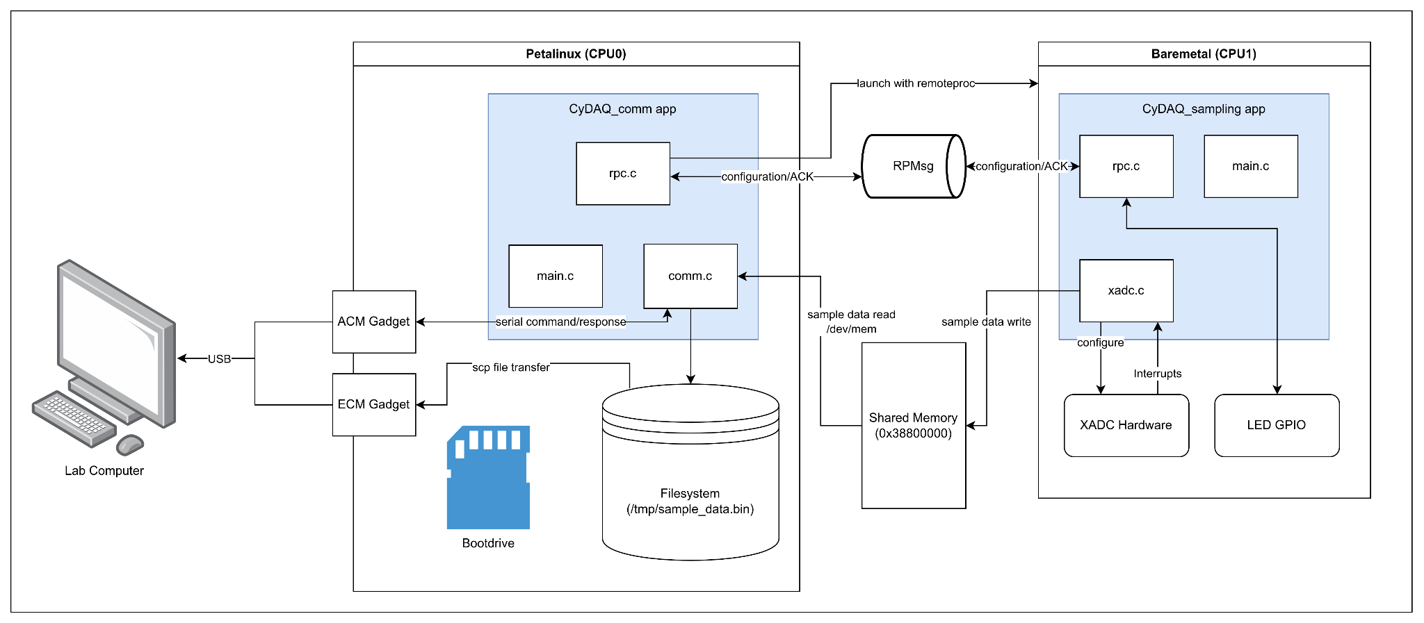
Implementation - Firmware

Slide 10
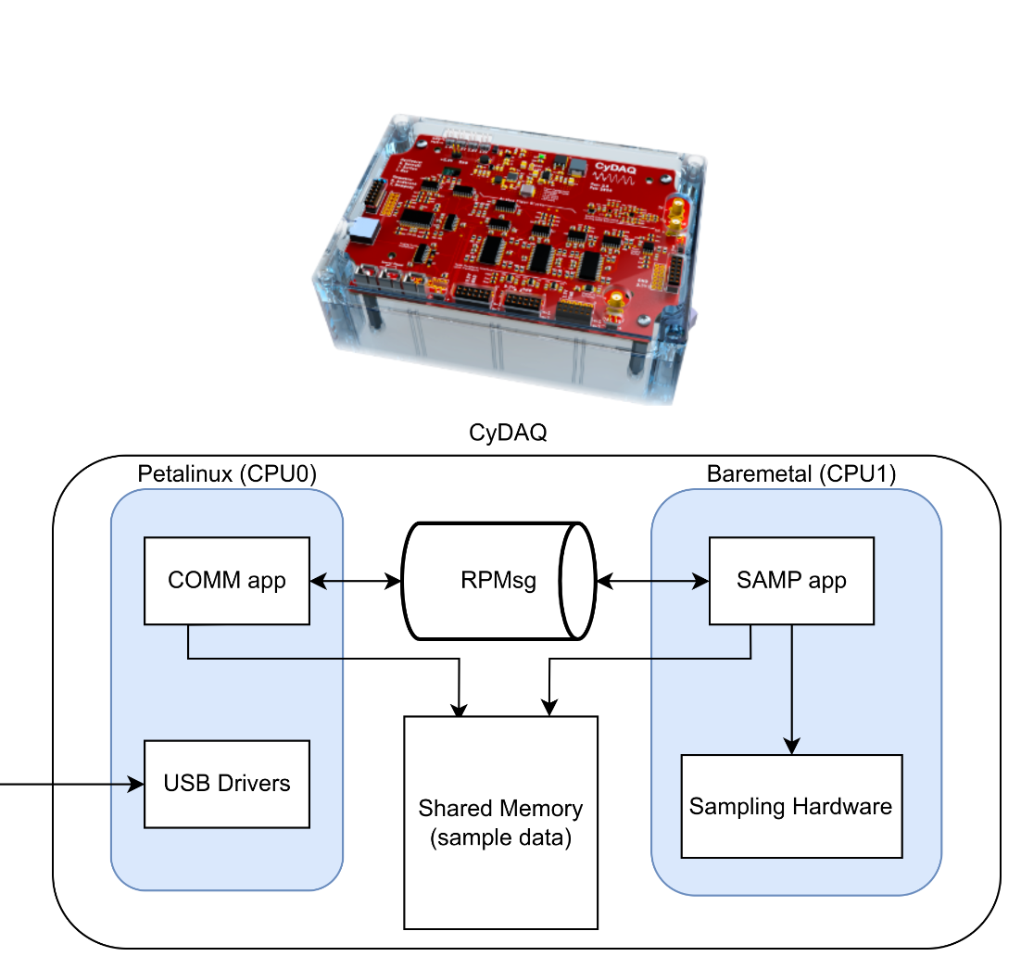
Implementation - Firmware
Petalinux(CPU0)
g_ether and g_serial
CyDAQ_comm application
Sample data stored on filesystem
Bare-metal(CPU1)
CyDAQ_sampling application
Configuration of hardware
ADC interrupts
Shared memory spaces
RPMsg
communication between two cores
Sample data

Slide 11
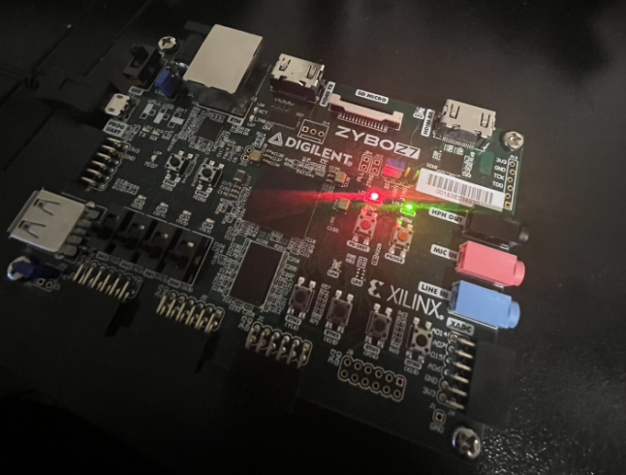
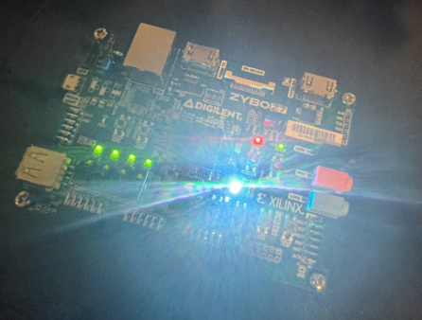
Implementation - Firmware - Hardware Design
Board BSP
Board support for Zybo Z7-10
LED GPIO
ability to control the 4 LEDs and 1 RGB LED on Zybo
boot indicator
AXI-Stream XADC and DMA
ability to store and access large amount of sample data
ability to stream sample data

Slide 12
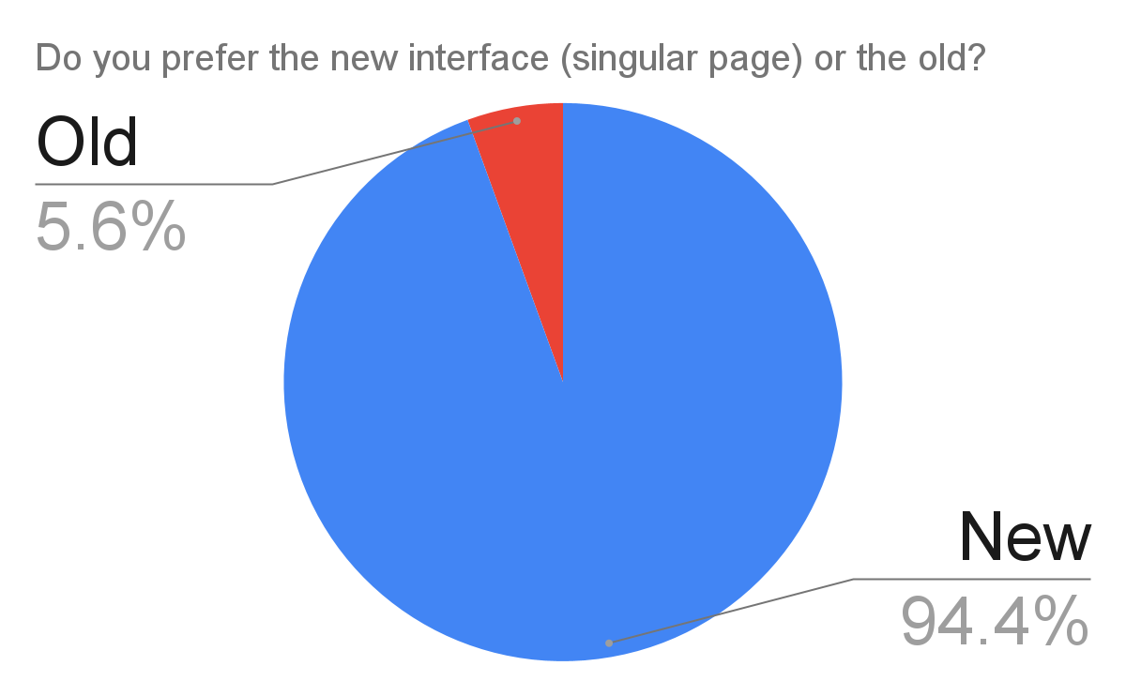
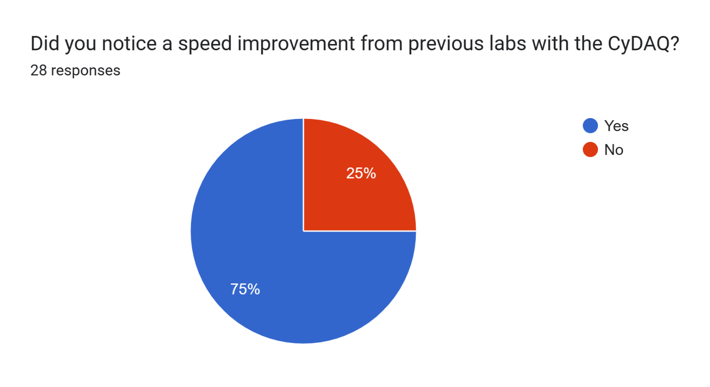
Lab Testing
Placed CyDAQ with new firmware in front of students
EE 224 - Signals and Systems I
Google Survey
17/18 students preferred the new GUI
21/28 students noticed a speed improvement
Handful of students had issues getting CyDAQ to connect
Made changes first week - greatly improved

Slide 13
03
Work Accomplishments

Slide 14
Work Accomplishments
491
CLI rewrite that supported old firmware
CLI Wrapper implemented
New GUI started that uses the CLI Wrapper
Basic Operation Mode
Live Plotter Mode Prototype
Firmware experiments on full bare-metal dual-core design
Communication core
Sampling Core
Create design documentation
Start Wiki
492
GUI .exe compile
Complete firmware rewrite
Petalinux configuration and build
Configure g_ether and g_serial USB drivers
OpenAMP implementation
Developed COMM and SAMP applications
Debug page and better logging
Prototype Balance Beam GUI Page
Live Plotting
Saving Sample/Plot data to .mat format
CLI Implementation for Balance Beam
User testing in EE224 labs
Finish Wiki
Notes:
Software
Full CLI and GUI redesign
Debug page and logging
Pyinstaller .exe to put on lab computers
Implemented reworked basic operation mode
Completely refractored serial connection
Firmware
Dual-Core with petalinux
Whatever else you firmware wizards did

Slide 15
04
Key Contributions

Slide 16
Key Contributions
Yohan - Implemented shared register for dual core, tested petalinux potential
Wyatt - Designed Balance Beam page and backend logic, logging, code refactoring/cleanup, directed wiki creation and organization
Blake - Designed and built the GUI
Cole - System testing on each release of GUI and firmware
Jens - Project management; Help with GUI and Wiki; System testing and bug fixing.
Long - Updated and modified the hardware design, ethernet over USB on the OTG port, modified the device tree file, modified COMM and SAMP firmware applications, implemented LED indicators
Corbin - Rebuilt CLI tool, implemented Petalinux kernel configuration, wrote COMM and SAMP firmware applications, mock mode

Slide 17
05
Challenges & Solutions

Slide 18
Challenges & Solutions
Compiling a single EXE file
Issue with relative pathing in Python, CLI & Wrapper files were not being packaged
Solution - implement a relative-to-absolute-path translator method
Existing Serial Implementation buggy and slow
Solution - completely refactored
Bare-metal implementation of USB CDC communication protocol
Buggy, dropped data, slow transfer speed
Solution - Petalinux with USB drivers
Crashes/bugs during labs
Caused interruptions for students and were hard to diagnose
Solution - implemented better logging library and system on GUI
Petalinux Build Difficulties
Lack of updated documentation and minimal support from Xilinx
Solution - Trial and error

Slide 19
06
Future Work

Slide 20
Future Work
Socket Communication
Module Level Logging
Web-Based GUI redesign
Speed Up The Boot Time Of The Onboard Linux
DAC Mode For Audio Signal
Linux Sandbox
Open-source and DSP experiments
Additional modes - new labs
Sampling rate testing on hardware FPGA
Strip development VM image down as much as possible
Petalinux installed on department server (doesn’t have Vitis, ETG can add it)
Python packaging could be optimized (msi installer)
Upgrade SD card for faster Petalinux boot

Slide 21
07
Conclusion

Slide 22
Conclusion
Working product
Positive results in lab environment
Improvement on existing product
Faster transfer speed
Easier-to-use GUI
Strong foundation for future Senior Design projects
Documentation - Wiki and Report
More options for GUI
CLI Wrapper
Petalinux brings lots of flexibility
Use in future labs

Slide 23
Thank You!

Slide 24
Please Check Out Our Wiki Here!

Slide 25
08
Appendix

Slide 26
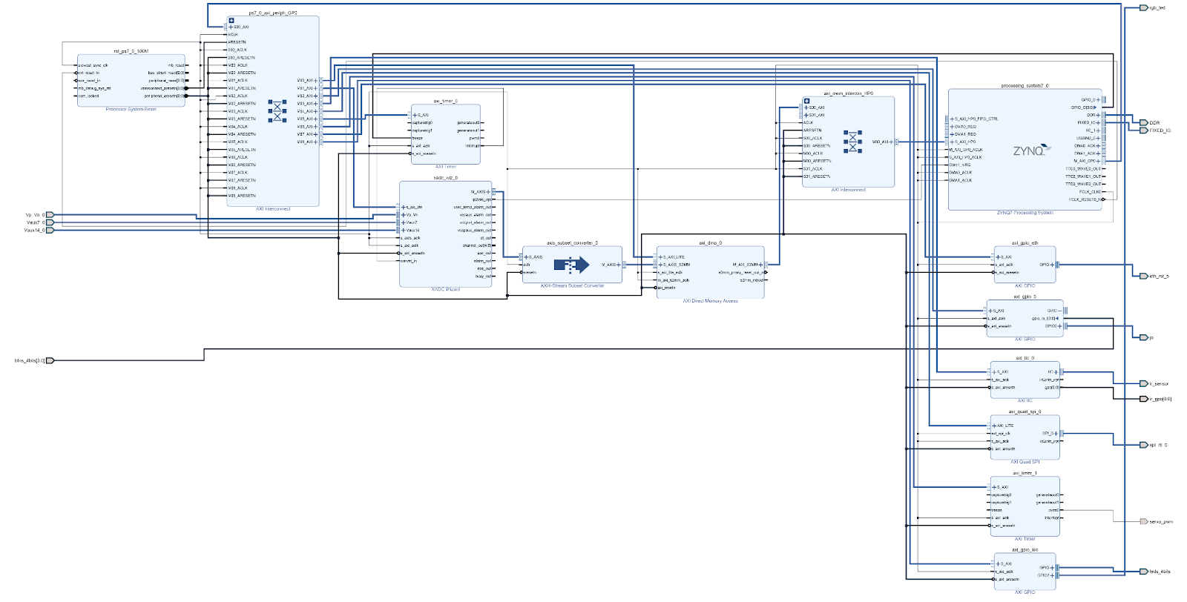
Overall Hardware Design schematic

Slide 27
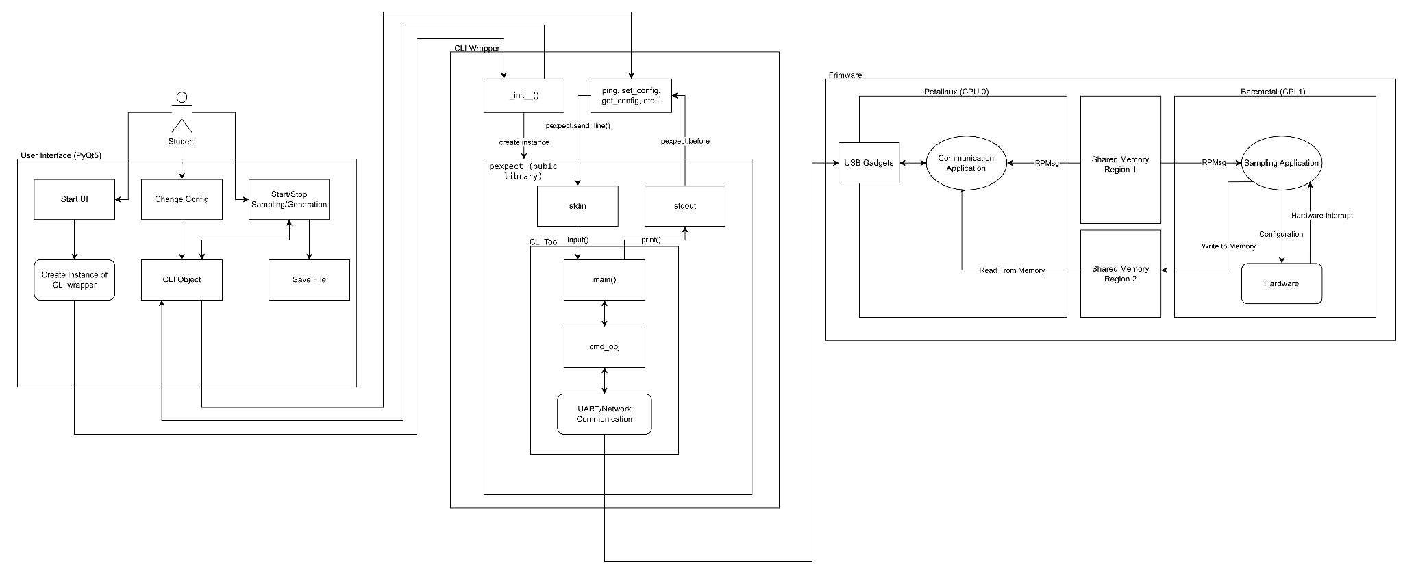
Overall Implementation Design schematic

Slide 28
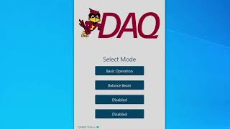
GUI

